Slide 1
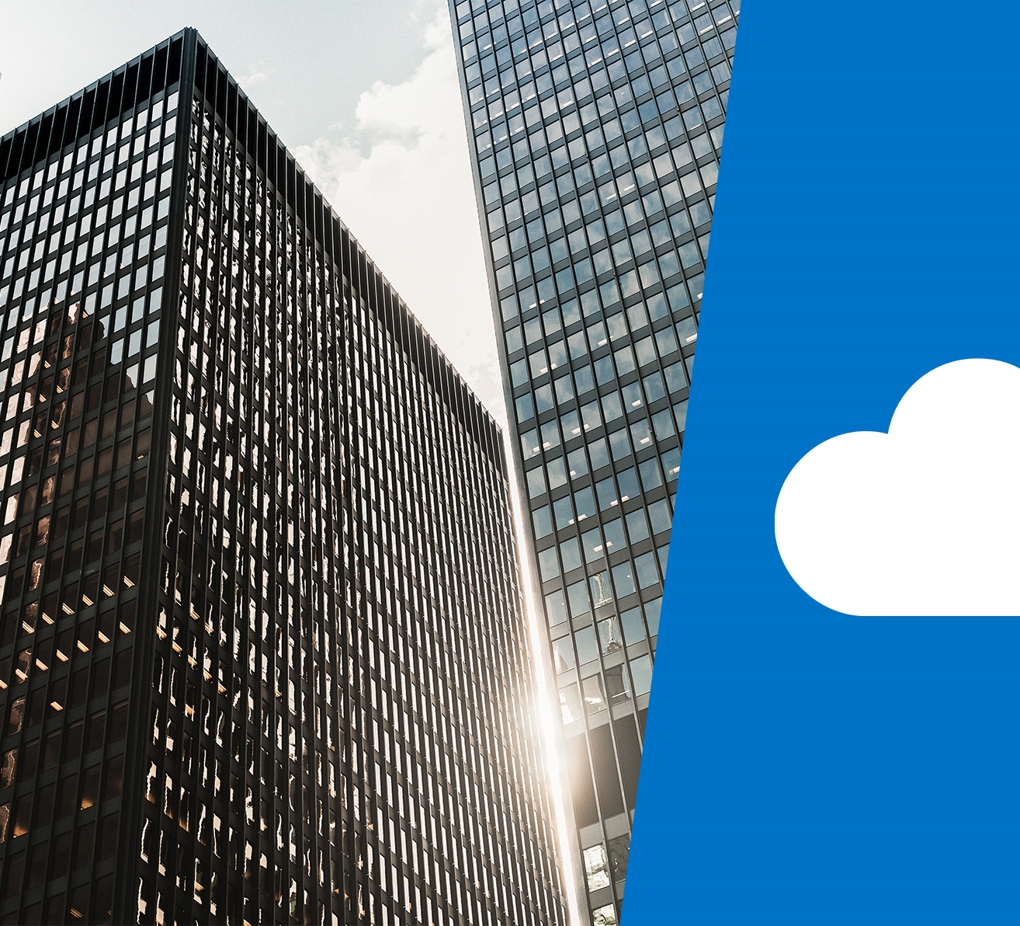
DP-201T04: Security Design Considerations

Slide 2
Lesson Objectives
Take a defense in depth approach to securing your architecture.
How to protect your identities.
Technologies to protect your Azure infrastructure.
Use encryption to secure your data.
Protect your architecture at the network level.
Leverage application security best practices

Slide 3
Common Principles
Confidentiality - Principle of least privilege.
Restricts access to information only to individuals explicitly granted access.
This information includes protection of user passwords, remote access certificates, and email content.
Integrity - The prevention of unauthorized changes to information at rest or in transit.
Availability - Ensure services are available to authorized users.
Denial of service attacks are a prevalent cause of loss of availability to users

Slide 4

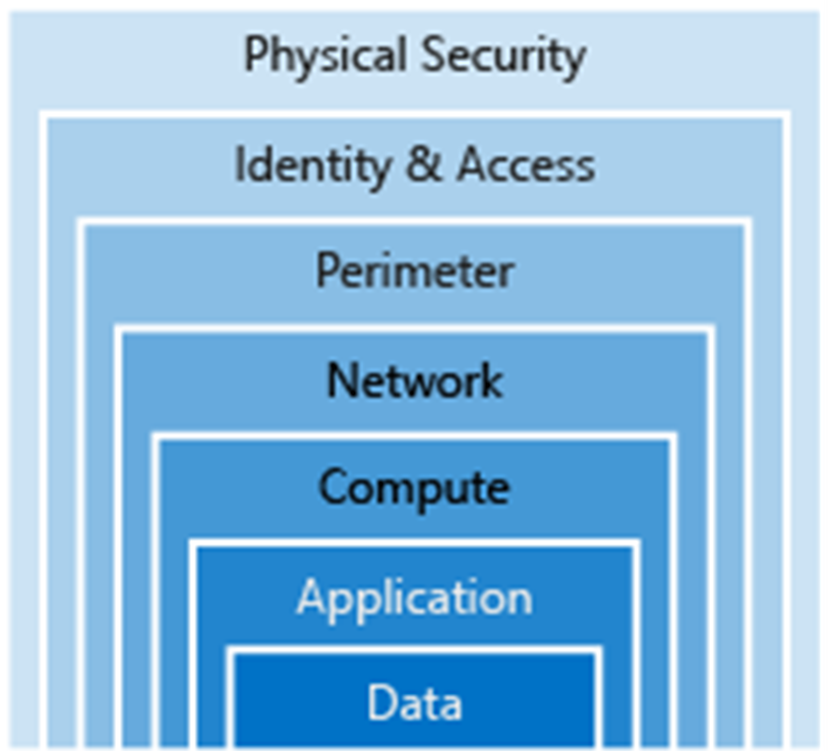
Defence in Depth Approach.

Slide 5
Security Layers
Data
Stored in a database
Stored on disk inside virtual machines
Stored on a SaaS application
Stored in cloud storage
Applications
Ensure applications are secure and free of vulnerabilities
Store sensitive application secrets in a secure storage medium
Make security a design requirement for all application development
Integrating security into the application development life cycle will help reduce the number of vulnerabilities introduced in code.

Slide 6
Security Layers
Compute
Secure access to virtual machines
Implement endpoint protection and keep systems patched and current
Malware, unpatched systems, and improperly secured systems open your environment to attacks
Networking
Limit communication between resources through segmentation and access controls
Deny by default
Restrict inbound internet access and limit outbound where appropriate
Implement secure connectivity to on-premises networks
At this layer, the focus is on limiting the network connectivity across all your resources to only allow what is required.
Segment your resources and use network level controls to restrict communication to only what is needed.

Slide 7
Security Layers
Perimeter
Use distributed denial-of-service (DDoS) protection to filter large-scale attacks before they can cause a denial of service for end users
Use perimeter firewalls to identify and alert on malicious attacks against your network
Policies & access
Control access to infrastructure, change control
Use single sign-on and multi-factor authentication
Audit events and changes
Physical security
Physical building security and controlling access to computing hardware within the data center is the first line of defense.

Slide 8
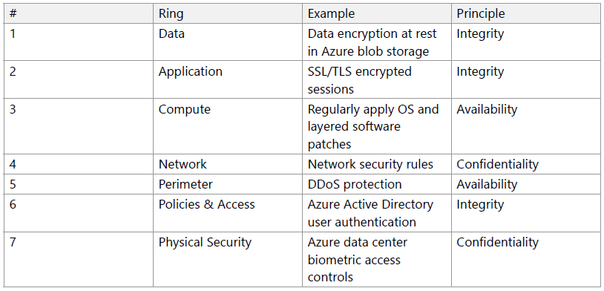
Defence in Depth - Examples

Slide 9
Identity Management
Identifying users that access your resources is an important part of security design.
Identity as a
security layer
Single sign-on
SSO with Azure Active Directory
Customers and employees alike expect to be able to access services from anywhere at any time, which has driven the development of identity protocols that can work at internet scale across many disparate devices and operating systems.
With single sign-on, users only need to remember one ID and one password. Access across database systems or applications is granted to a single identity tied to a user
Azure Active Directory (AD) is a cloud-based identity service. It has built-in support for synchronizing with your existing on-premises Active Directory or can be used stand-alone. This means that all your applications, whether on-premises, in the cloud (including Office 365), or even mobile can share the same credentials.
Notes:
Identity as a layer of security
In the past, identity and access services were restricted to operating within a company's internal network, using protocols such as Kerberos and LDAP that were designed for this purpose.
More recently, mobile devices have become the primary way people interact with digital services. Customers and employees alike expect to be able to access services from anywhere at any time, which has driven the development of identity protocols that can work at internet scale across many disparate devices and operating systems
Single sign-on
The more identities a user has to manage, the greater the risk of a credential-related security incident. More identities mean more passwords to remember and change.
Password policies can vary between applications, and as complexity requirements increase, it makes it more difficult for users to remember them.
On the other side is the management required for all those identities. Additional strain is placed on help desks as they deal with account lockouts and password reset requests

Slide 10
Infrastructure Protection
Role Based Access Control (RBAC)
Roles are defined as collections of access permissions. Security principals are mapped to roles directly or through group membership.
Providing identities to services
An Azure service can be assigned an identity to ease the management of service access to other Azure resources.
Roles and management groups
Roles are sets of permissions that users can be granted to. Management groups add the ability to group subscriptions together and apply policy at an even higher level.
Privileged Identity Management
Azure AD Privileged Identity Managemen (PIM) is an additional paid-for offering that provides oversight of role assignments, self-service, and just-in-time role activation (auditing)
Service principals
A Service Principal is literally named. It is an identity that is used by a service or application. Like other identities, it can be assigned roles
Managed identities
When you create a managed identity for a service, you create an account on the Azure AD tenant. Azure infrastructure will automatically take care of authentication
Notes:
Separating security principals, access permissions, and resources provides simplified access management and more fine-grained control.
On Azure, users, groups, and roles are all stored in Azure Active Directory (Azure AD). The Azure Resource Manager API uses role-based access control to secure all resource access management within Azure
Roles and management groups
Roles are sets of permissions, like “Read-only” or "Contributor", that users can be granted to access an Azure service instance.
Roles can be granted at the individual service instance level, but they also flow down the Azure Resource Manager hierarchy.

Slide 11
Service principals
An identity is just a thing that can be authenticated.
It can also include applications or other servers, which might authenticate with secret keys or certificates.
An account is data associated with an identity.
A principal is an identity acting with certain roles or claims.
Consider the use ‘sudo’ on a bash prompt or on Windows using "run as Administrator". In both of those cases, you are still logged in as the same identity as before, but you've changed the role under which you are executing.
A Service Principal is literally named.
It is an identity that is used by a service or application.
It can be assigned roles.

Slide 12
Managed identities for Azure resources
The creation of service principals can be a tedious process and maintaining them is difficult.
Managed identities for Azure resources are much easier
A managed identity can be instantly created for any Azure service that supports it.
You are creating an account on the Azure AD tenant.
Azure infrastructure will automatically take care of authenticating the service and managing the account.
You can then use that account like any other AD account including securely letting the authenticated service access other Azure resources

Slide 13
Encryption
Encryption is the process of making data unreadable and unusable.
To use or read the encrypted data, it must be decrypted, which requires the use of a secret key.
Symmetric encryption uses the same key to encrypt and decrypt the data.
Asymmetric encryption uses a public key and private key pair.
Either key can encrypt but cannot decrypt its own encrypted data.
To decrypt, you need the paired key.
Asymmetric encryption is used for things like Transport Layer Security (TLS) (used in https), and data signing.

Slide 14
Encryption
Encryption at rest
Data at rest is the data that has been stored on a physical medium. This could be data stored on the disk of a server, data stored in a database, or data stored in a storage account.
Encryption on Azure.
Raw Encryption
Enables the encryption of:
Azure Storage
V.M. Disks
Disk Encryption
Database Encryption
Enables the encryption of databases using:
Transparent Data Encryption
Encrypting Secrets
Azure Key Vault is a centralized cloud service for storing your application secrets.
Encryption in transit
Data in transit is the data actively moving from one location to another, such as across the internet or through a private network. Secure transfer can be handled by several different layers.

Slide 15
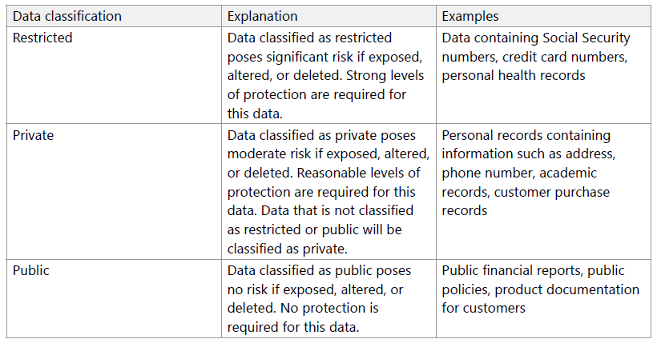
Identify and Classify Data
Notes:
Identify and classify data
If an organization have had previous incidents that exposed sensitive data, there's a gap between what they are encrypting and what they should be encrypting.
They need to start by identifying and classifying the types of data they are storing and align this with the business and regulatory requirements surrounding the storage of data.
It's beneficial to classify this data as it relates to the impact of exposure to the organization, its customers, or partners.
By taking an inventory of the types of data being stored, they can get a better picture of where sensitive data may be stored and where existing encryption may or may not be happening.

Slide 16
Encrypting secrets
Azure Key Vault is a cloud service that works as a secure secrets store.
Key Vault allows you to create multiple secure containers, called vaults.
Vaults are backed by hardware security modules (HSMs).
Help reduce the chances of accidental loss of security information by centralizing the storage of application secrets.
Key Vaults also control and log the access to anything stored in them.
Key Vault is designed to support any type of secret.
These secrets could be passwords, database credentials, API keys and certificates.
Applications using managed identities for Azure services can automatically and seamlessly acquire the secrets they need.

Slide 17
Database Encryption - Transparent Data Encryption (TDE)
Encrypts SQL Server, Azure SQL Database, and Azure Synapse Analytics data files. This encryption is known as encrypting data at rest.
TDE does real-time I/O encryption and decryption of data and log files. The encryption uses a database encryption key (DEK).
Symmetric key. It's secured by a certificate that the server's master database stores
It lets you follow many laws, regulations, and guidelines established in various industries.
This ability lets software developers encrypt data by using AES and 3DES encryption algorithms without changing existing applications.

Slide 18
Database Encryption - Always Encrypted
You can configure Always Encrypted for individual database columns containing your sensitive data.
Always Encrypted makes encryption transparent to applications.
An Always Encrypted-enabled driver installed on the client computer achieves this by automatically encrypting and decrypting sensitive data in the client application.
The driver encrypts the data in sensitive columns before passing the data to the Database Engine, and automatically rewrites queries so that the semantics to the application are preserved.
Similarly, the driver transparently decrypts data, stored in encrypted database columns, contained in query results.

Slide 19
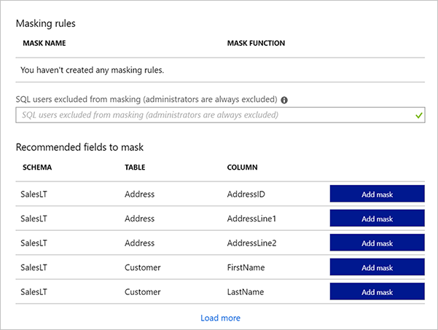
Dynamic Data Masking
https://docs.microsoft.com/en-us/azure/sql-database/sql-database-dynamic-data-masking-get-started
Notes:
Instructor notes
This capability is available in Azure SQL Database and Azure Synapse Analytics. You can read more information at:
https://docs.microsoft.com/en-us/azure/sql-database/sql-database-dynamic-data-masking-get-started

Slide 20
Dynamic data masking
Data masking rules consist of the column to apply the mask to, and how the data should be masked.
You can create your own masking format, or use one of the standard
Default value, which displays the default value for that data type instead.
Credit card value, which only shows the last four digits of the number, 4564 4455 4555 XXXX
Email, which hides the domain name and all but the first character of the email account name.
Number, which specifies a random number between a range of values.
Custom string.
Notes:
Instructor notes
This space has been left deliberately blank.

Slide 21
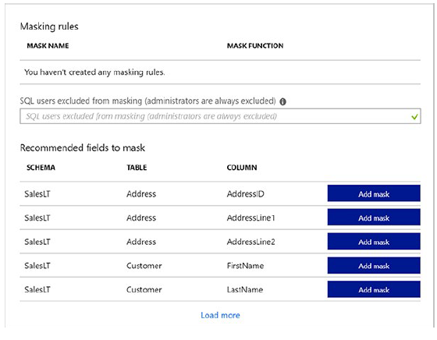
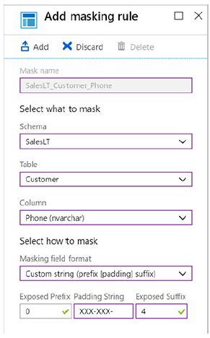
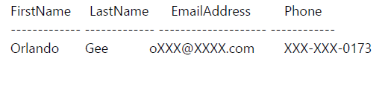
Dynamic data masking
Notes:
Instructor notes
This space has been left deliberately blank.

Slide 22
Network Security
Network security is protecting the communication of resources within and outside of your network. The goal is to limit exposure at the network layer across your services and systems
Internet protection
A great first place to start is to assess the resources that are internet-facing, and only allow inbound and outbound communication where necessary. Identify all resources that are allowing inbound network traffic of any type, and ensure they are necessary and restricted to only the ports/protocols required.
Virtual network security
To isolate Azure services to only allow communication from virtual networks, use VNet service endpoints. With service endpoints, Azure service resources can be secured to your virtual network.
Network integration
VPN connections are a common way of establishing secure communication channels between networks, and this is no different when working with virtual networking on Azure. Connection between Azure VNets and an on-premises VPN device is a great way to provide secure communication.
Notes:
Azure Security Center is a great place to look for this information, as it will identify internet-facing resources that don't have network security groups (NSG) associated with them, as well as resources that are not secured behind a firewall

Slide 23
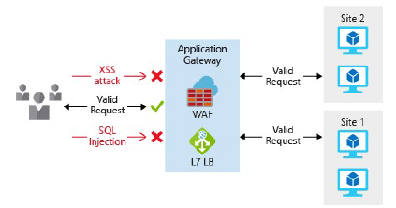
Protecting the Perimeter
Application Gateway is a Layer 7 load balancer that also includes a web application firewall (WAF) to provide advanced security for your HTTP-based services.
The WAF is based on rules and provides protection from commonly-known vulnerabilities such as cross-site scripting and SQL injection.

Slide 24
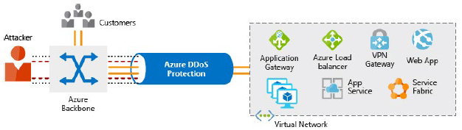
Azure DDoS
Azure DDoS provides basic protection across all Azure services and enhanced protection for further customization for your resources.
DDoS protection blocks attack traffic and forwards the remaining traffic to its intended destination.
Within a few minutes of attack detection, you are notified using Azure Monitor metrics.

Slide 25
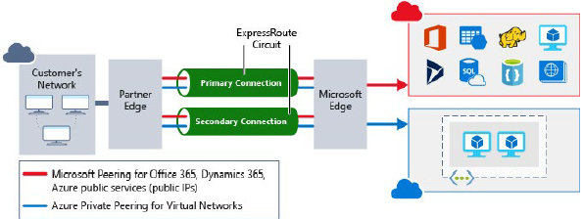
Network integration
ExpressRoute lets you extend your on-premises networks into the Microsoft cloud over a private connection facilitated by a connectivity provider.
This improves the security of your on-premises communication by sending this traffic over the private circuit instead of over the internet.
You don't need to allow access to these services for your end users over the internet.

Slide 26
Application Security
Security
Development
Lifecycle
Operational
security
assessment
Identity
as the
perimeter
Data
Protection
Secure key
and
secret storage

Slide 27
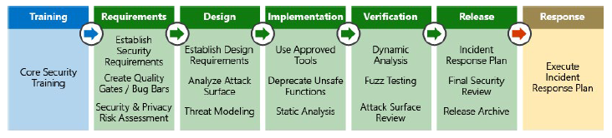
Security Development Lifecycle
Can be used during the application design stage to ensure security concerns are incorporated in the software development lifecycle.
Security and compliance issues are far easier to address when designing an application and can mitigate many common errors that can lead to security flaws in the final product.

Slide 28
Operational security assessment
Security vulnerability scanning software services are available to help automate this process.
Azure Security Center is a free service, that is tightly integrated with other services, such as Application Gateway and Web Application Firewall.
By analyzing logs from these services, ASC can report on known vulnerabilities in real time.

Slide 29
Data protection
Secure storage and transport of data between an application and its data storage layer is paramount.
Organizations can modify their applications to encrypt all data at rest and in transit.
Encrypt data exchanged between the web application and back-end SQL databases.
Data is also encrypted at rest in SQL Server using TDE, ensuring that even if the environment is compromised, data is effectively useless to anyone without the correct decryption keys.
To encrypt data stored in blob storage, client-side encryption can be used to encrypt the data in memory before it's written to the storage service.

Slide 30
Secure key and secret storage
Encryption keys and application secrets should never be stored in the application code of configuration files.
Instead, a secure store such as Azure Key Vault should be used.
Access to this sensitive data can then be limited to application identities through Managed Service Identities, and keys can be rotated on a regular basis to limit exposure in the case of encryption key leakage.
Customers can also choose to use their own encryption keys generated by on-premises Hardware Security Modules (HSM) and even mandate that Azure Key Vault instances are implemented in single-tenant, discrete HSMs.

Slide 31

Lab: Azure Data Platform Security Design Considerations

Slide 32
Lab overview
The students will explore the range of security options that are available to provide a defence in depth approach to securing the AdventureWorks environment. This will include investigating the available network protection options that are available, as well as the authentication mechanisms that are support by each service. The students will also understand the encryption options that are available and demonstrate an understanding of network level and application level protection.
Lab objectives
After completing this lab, you will be able to:
1. Defense in Depth Security Approach
2. Identity Management

Slide 33
Lab scenario
You have recently been hired as a senior data engineer at AdventureWorks and are working with a consultant and architects to design a security approach for cloud data platform solution that meets the organizations technical and business requirements.
Working in a group, you will be performing a security assessment of the architectures that have been defined so that there is a defense in depth approach to securing the environment. Firstly, you will create a document to show the aspects of the architecture that require securing. You will then specify the identity management approach that is required.
It is important that you should be able to justify your choices as a team, and you are encouraged to use references from Microsoft such as Microsoft documentation, or blogs from Microsoft to provide evidence that supports your choices.
At the end of this lab, you will have defined:
1. Defense in Depth Security Approach
2. Identity Management

Slide 34
Lab review
Exercise 1 – Explore the answers given by each group. What was the common ground? What were the differences?
Exercise 2 – Who should be involved in the design process for authentication?
Are there other security areas that should be considered in depth?

Slide 35
Lab review
Exercise 1 - Task 1: Defence in depth approach
Requirement | Defence in Depth Category
Only internal access allowed to the Azure SQL Data Warehouse | Identity & Access
The connected bicycle must have secure connections to 1st and 3rd party applications | Physical Security Network Access
Use Azure Active Directory integration in the first instance | Identity & Access
Restrict Access to services based on IP Address | Network Perimeter
Encrypt data in Rest | Data (Encryption)
Use Shared Access Signatures for access to data stores required by external vendors. | Identity & Access
Enable database auditing to monitor data access | Identity & Access
Use Azure Key Fault to safeguard keys and secrets | Physical Security Identity & Access
Protect data in transit | Data (Encryption)
Use Role Based Access control | Identity & Access
Limit administrative access to services and resources | Identity & Access Compute
Ensure Application Level Security for third party applications | Application

Slide 36
Lab review
Exercise 2 - Task 1: Identity Management
Technology | Requirement | Primary Authentication
Azure Blob | Website image storage | Shared Access Signatures
Data Lake Store Gen II | Staging Data for Data Warehouse and Databricks | Azure Active Directory
SQL Database | Current Sales /Ordering System | SQL Authentication
Data Warehouse | Historical reporting and descriptive analytics | Azure Active Directory
Cosmos DB | Storage and access of Bot conversation data | Resource Tokens
Databricks | Used to perform predictive analytics (REST API) | Token based authentication
Event Hubs | Used to captured social media data | Shared Access Policies

Slide 37
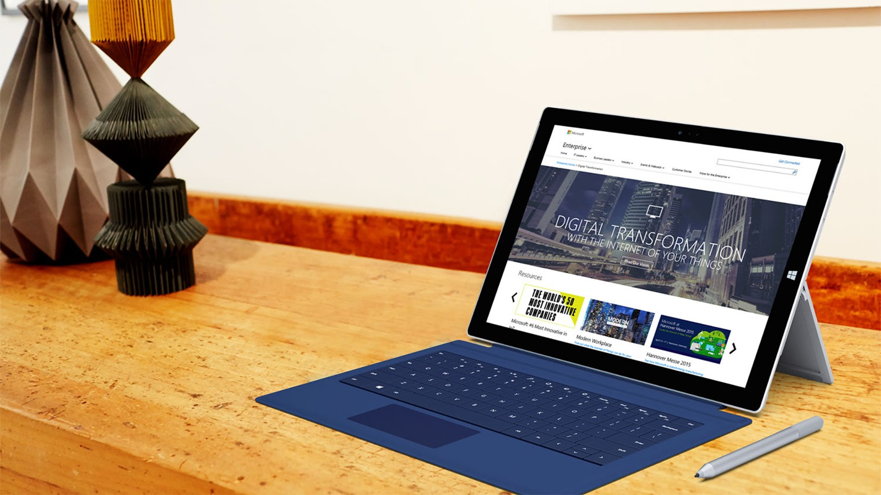
Next steps
Module Summary
In this module, you have learned about:
- Take a defense in depth approach to securing your architecture.
- How to protect your identities.
- Technologies to protect your Azure infrastructure.
- Use encryption to secure your data.
- Protect your architecture at the network level.
- Leverage application security best practices
After the course, use the Azure Security Center to keep track of security updates to the products that you are interested in.

